Slide 1


Slide 2

why not to learn something new?
Sławomir Drzymała

Slide 3
why not to learn something new?
Sławomir Drzymała
t r y

Slide 4







about me
Sławomir Drzymała
Business Intelligence Consultant
Speaker at the conferences
Organizer (meetups, hackathon’s)
Cofounder of pl.seequality.net
Passionate about data
slawomirdrzymala@outlook.com
sdrzymala
SDrzymala
sdrzymala
seequality

Slide 5

intro
Let’s start with a confession…
I was focus too much on one technology and one vendor…
Too afraid to start learning something new, everything too complex
Time to change
Do u recognize yourself here as well?
How to proceed?
Try to find a good learning materials
Don’t think that everything is complex
Step by step, slice the elephant and don’t focus on the details
Create a pet project!

Slide 6

the pet project
Pet project - A project, activity or goal pursued as a personal favorite, rather than because it is generally accepted as necessary or important.
Pick up something (topic and tools) that are most interesting for you and do it!
Today, I will show you mine pet project!
As we will go through each demo, we will try to get some knowledge about the technology itself.
Image source: dev.to

Slide 7
project – radio playlist analysis
Goal – learn some cloud services, also make a machine learning model to predict if the song will be played in a given month or not. PS we could use many different technologies, that my proposal, what would be yours?
start
end

Slide 8


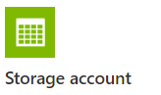

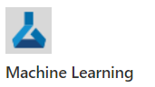


radio playlist analysis
local
aws
azure
data lake
local

Slide 9
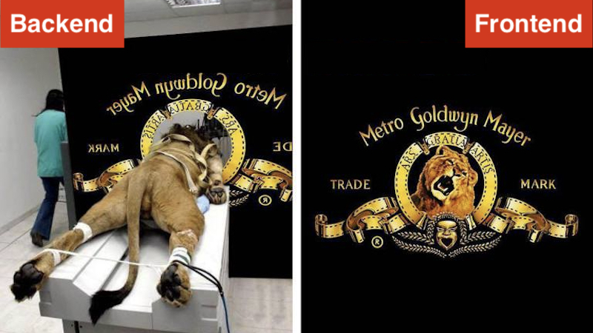
fasten your seatbelt
Focus on use cases, as well as on the technology, some theory, some demos
Simplified, but still practical
Shortcuts, don’t copy-paste to PRD
Everything and more on Github
Demos and enhanced demos
Additional resources and link and tutorials
It might be a bit fast…
Image source: getworkz.com

Slide 10
agenda
Intro – intro, idea, goal and project description - already behind us
Demo and theory…
python and webscraping – intro + demo
data lake – intro + demo
databricks – intro + demo
power bi – intro + demo
machine learning + azure machine learning – intro + demo
Outro – recap, further steps, the message

Slide 11


python / programming
Python is an interpreted high-level general-purpose programming language
Python or “any” other language – R, C#, Java, Scala, C#, F#, JavaScript, Julia, etc
Why python – because you can start with simple script, is easy to start, you can use for scripts, data science, web dev
Read more: [link], [link], [link], [link], [link]

Slide 12
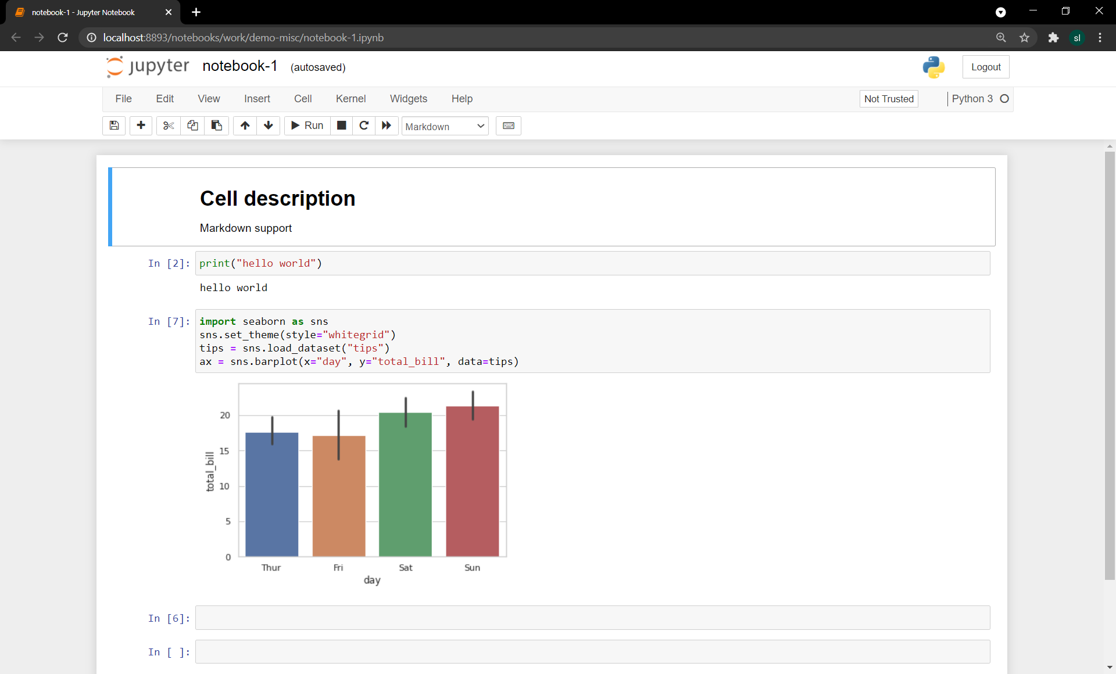
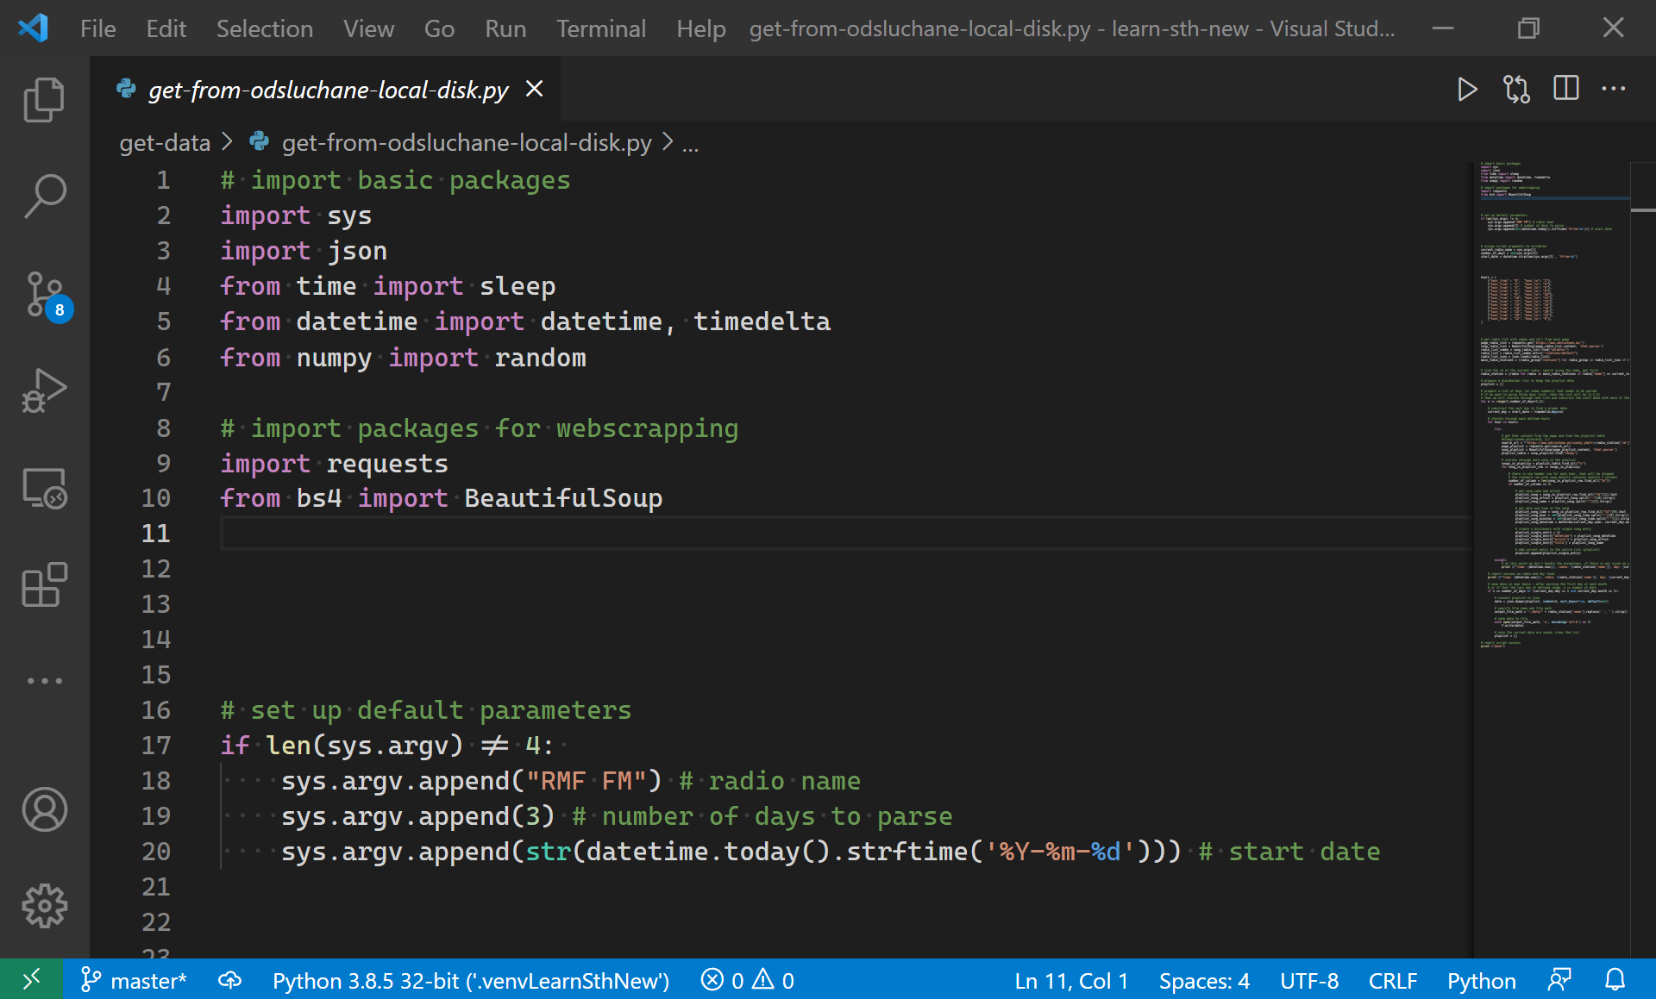
python / programming

Slide 13
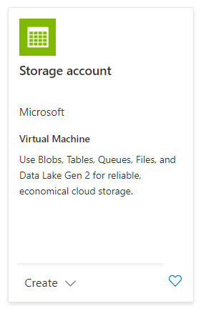
data lake
Data lake - is a centralized repository that allows you to store all your structured and unstructured data at any scale
Data partitioned and organized in layers (directories) that describes state of data in given layer
Data stored usually as parquet files
Key challenge is to properly design the lake for processing and security needs
Read more: [link], [link], [link], [link], [link]
data lake
raw (/sap/2020/06/glpca_20210605_112305.csv)
curated (/sap/2020/06/glpca.parquet)
enriched
analytics
sandbox
Partitioning /layer/source/companycode/year/month/day/file.parquet

Slide 14
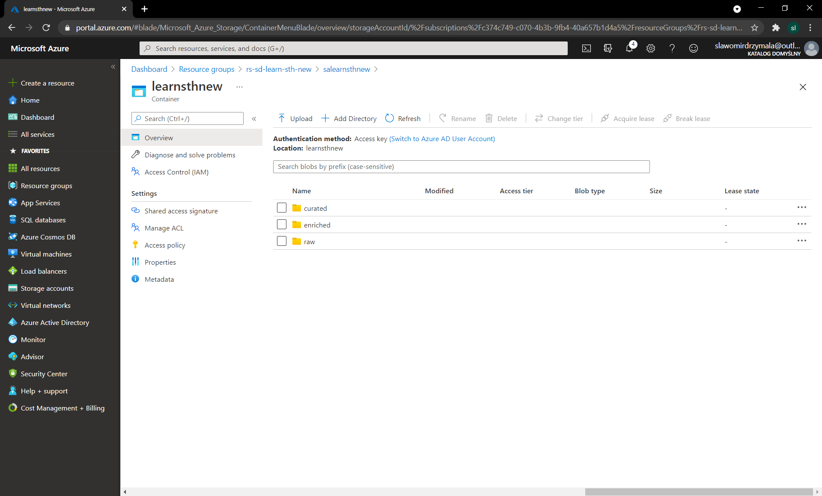
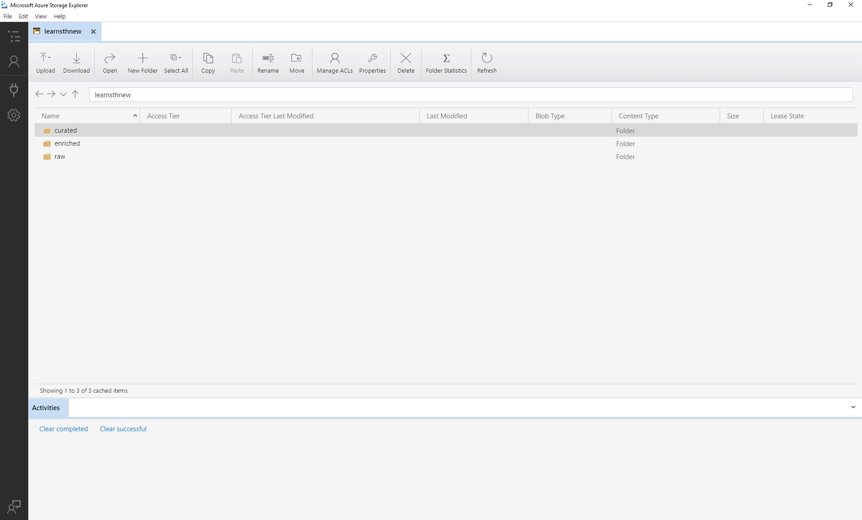
data lake

Slide 15
demo python + data lake

Slide 16
docker
Docker - biggest company and the biggest project that develop the containers. Runs everywhere and there is a free version
Docker, basically containers, supports OS virtualization i.e. your application feels that it has a complete instance of an OS
Images are base to run the containers
Used to develop, test and run apps
Read more: [link], [link], [link], [link], [link]
Datascience notebook
Django
Custom
Python
Redis
Ubuntu (base)

Slide 17
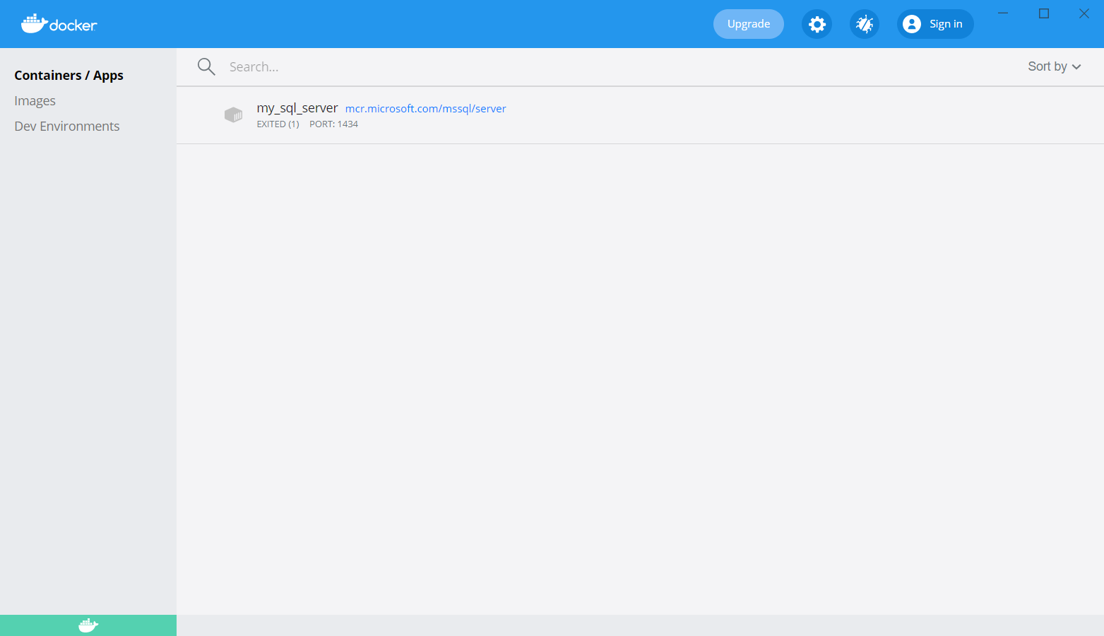
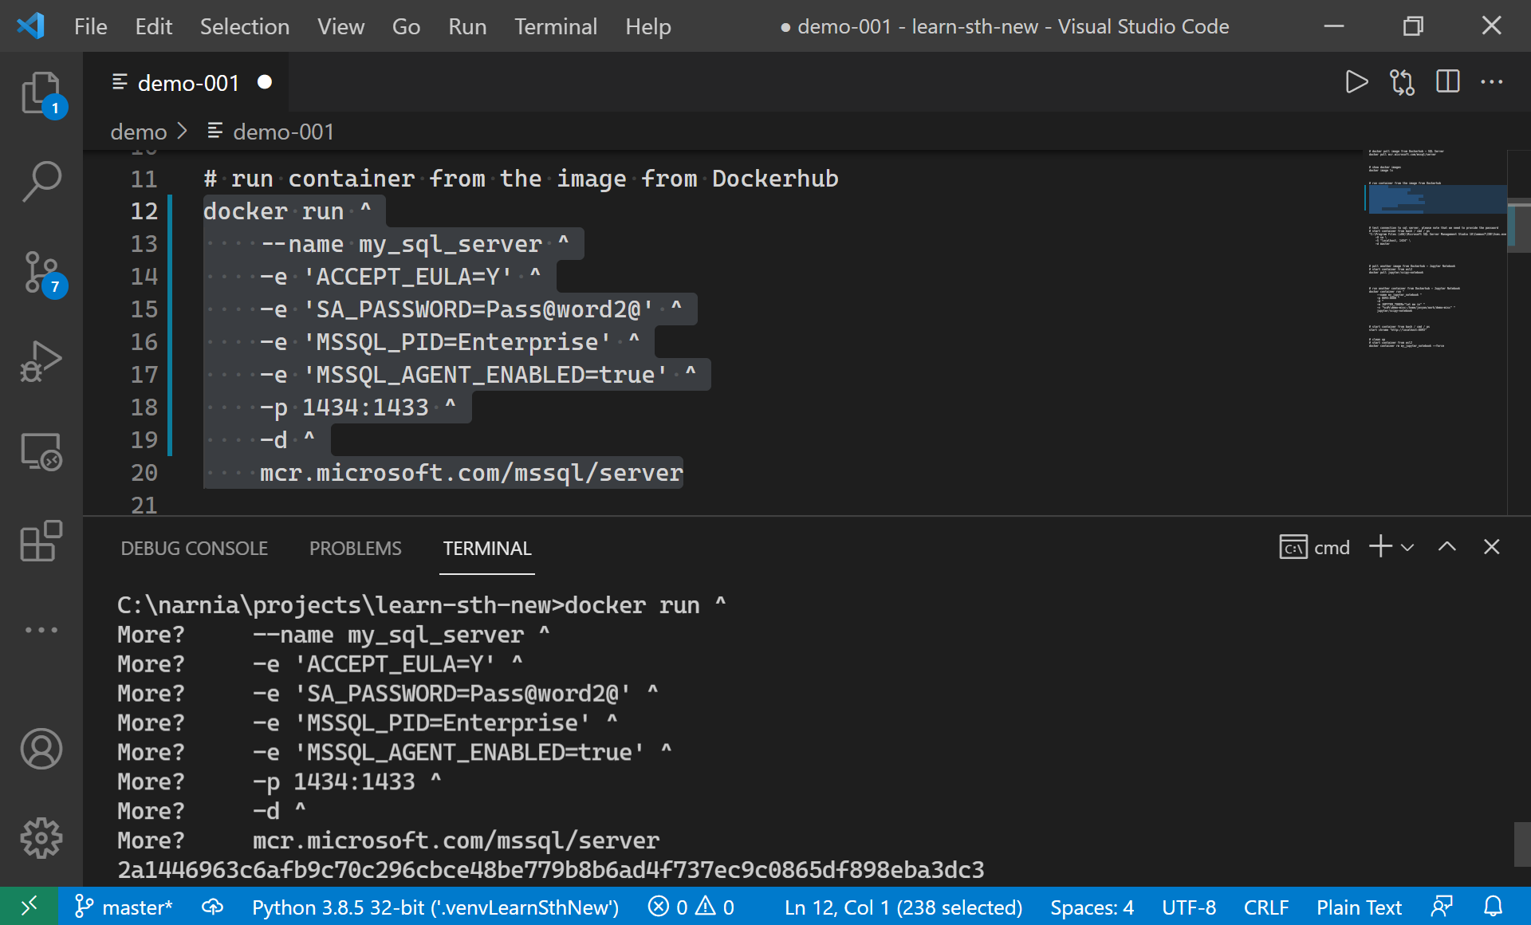
docker

Slide 18
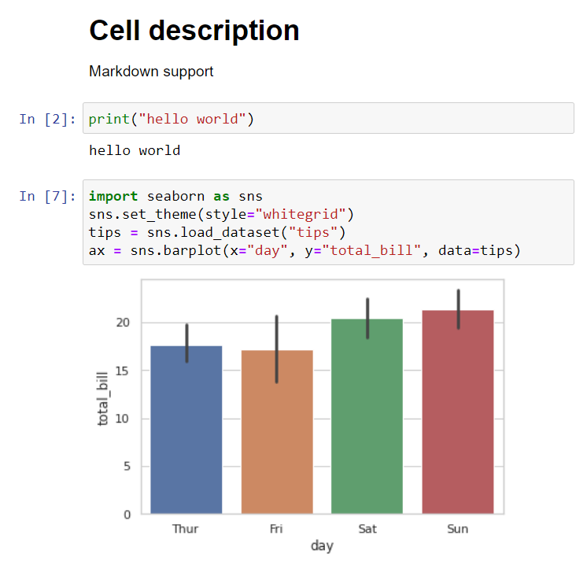
notebooks
Notebook – usually web application to write the code interactively in document-style workbook; with support for visualization and markdown; sometimes multilingual
Notebooks can be found - Jupyter Notebooks, Google Colab Notebook, Azure Data Studio, Databricks Notebooks
Read more: [link] [link] [link] [link] [link] [link], [link], [link], [link], [link], [link]

Slide 19
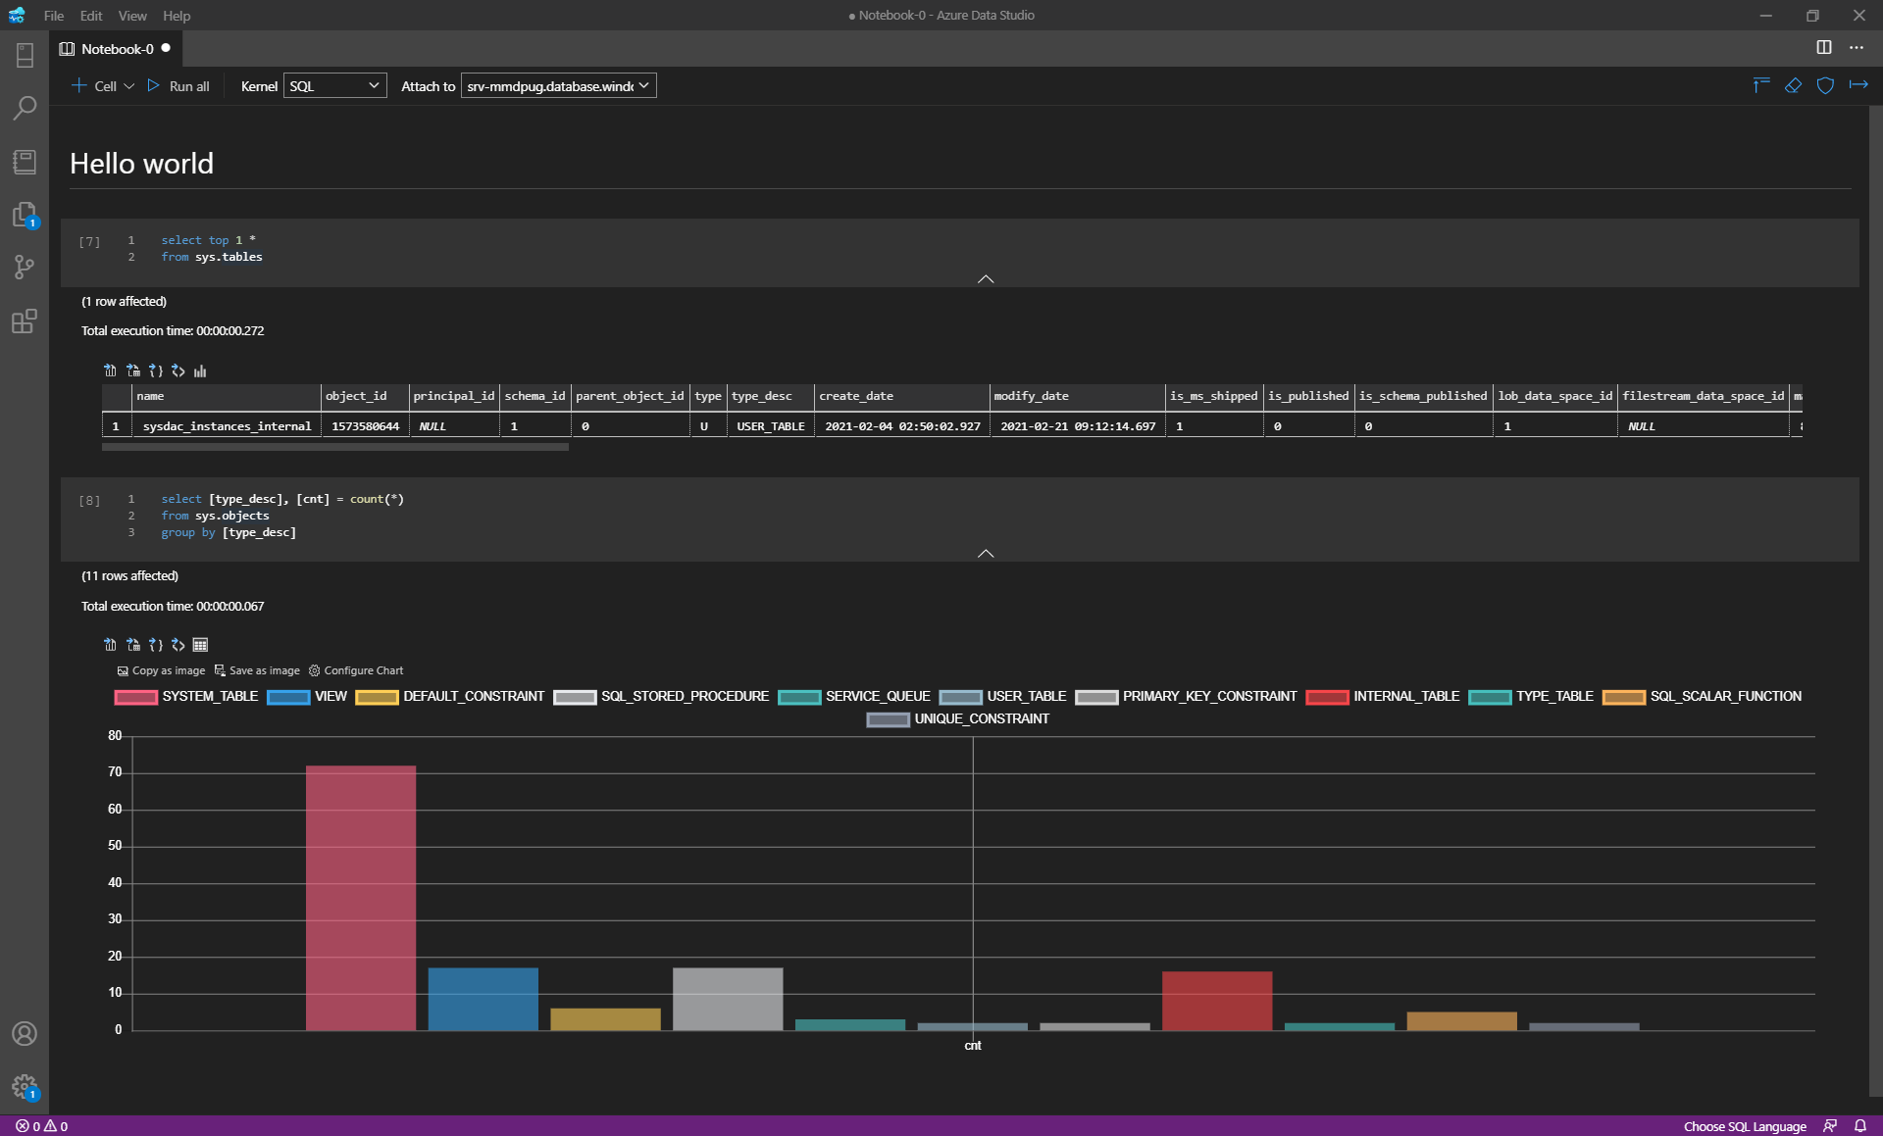
notebooks

Slide 20
radio playlist analysis
local
aws
azure
data lake
local

Slide 21
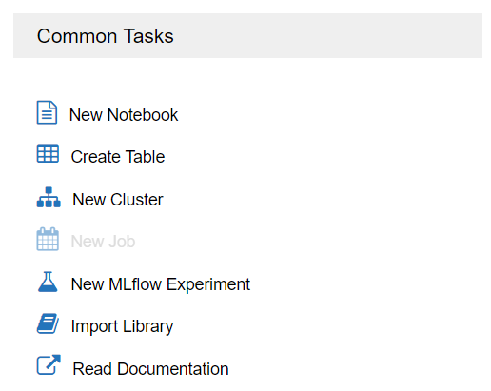
databricks
How to process large amount of the data?
Apache Spark is an open-source unified analytics, based on clusters, engine for large-scale data processing
Databricks - is a fast, easy, and collaborative Apache Spark-based analytics service designed for data science and data engineering.
Notebook style that supports many languages Python, Scala, R, Java, and SQL
Read more: [link], [link], [link], [link], [link]

Slide 22
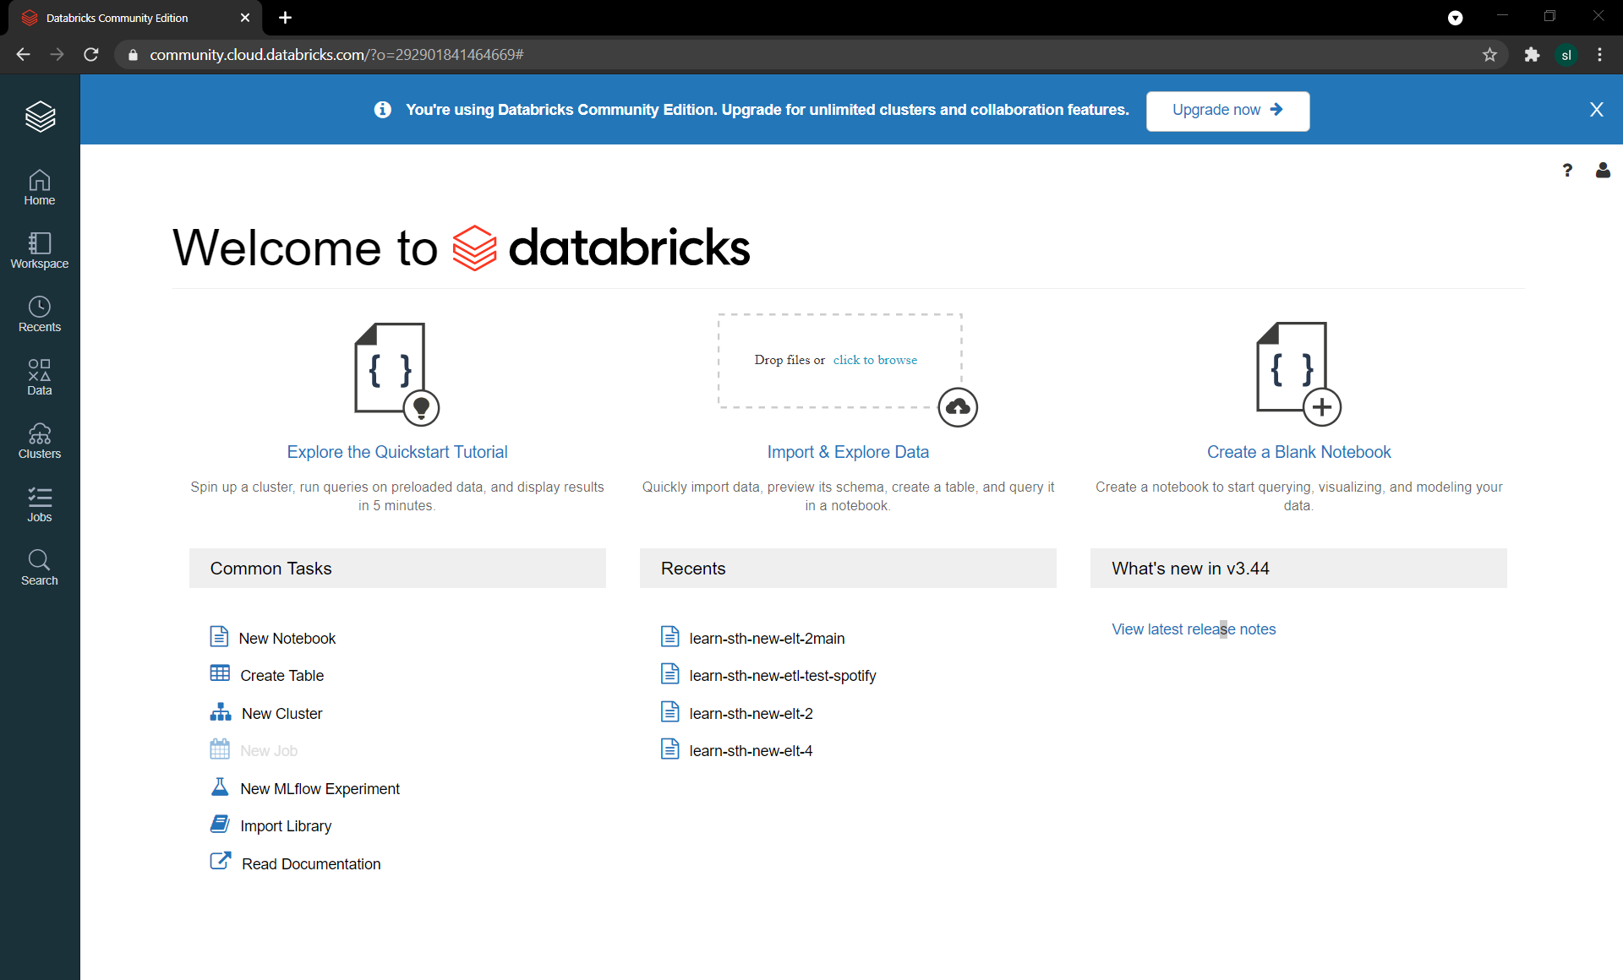
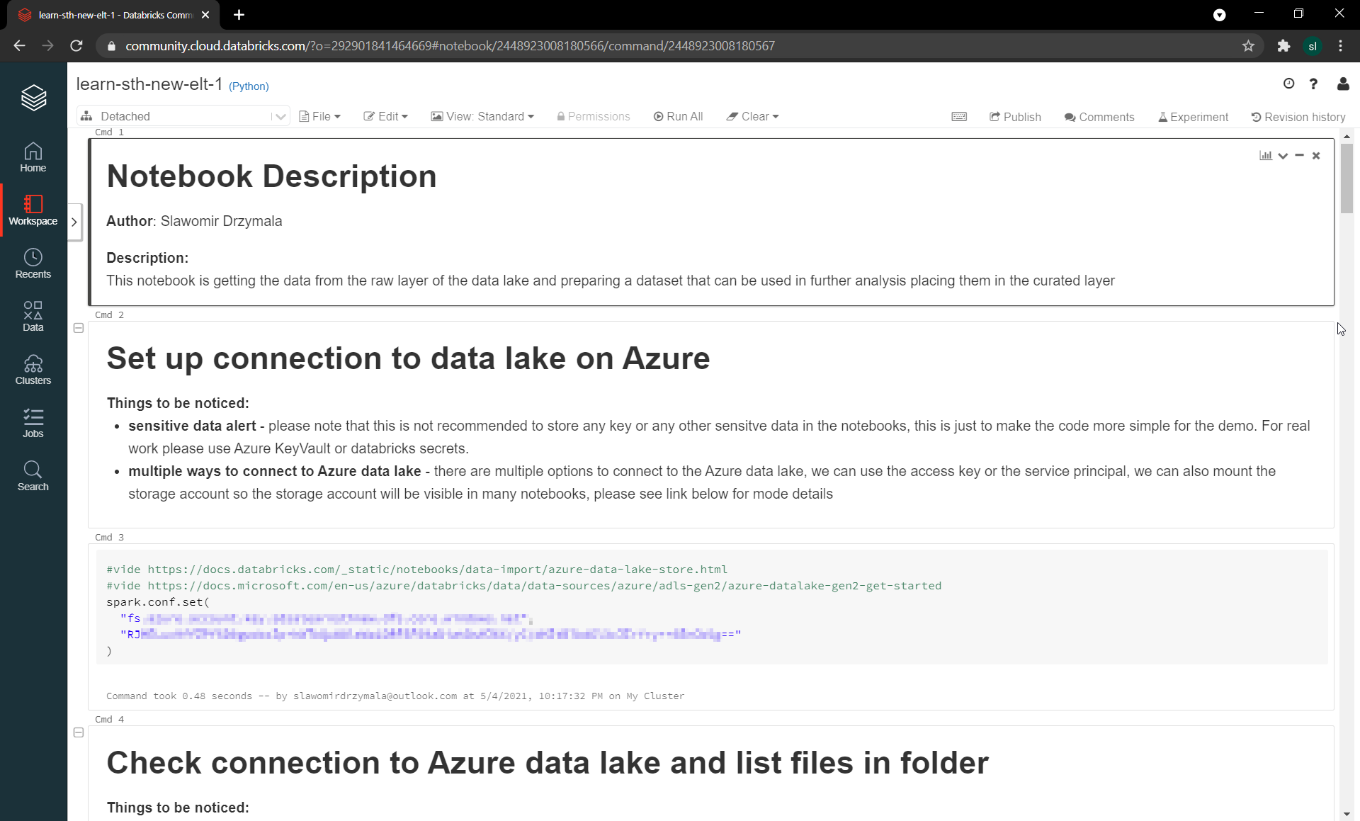
databricks

Slide 23
databricks
learn-sth-new-elt-1 notebook get data from raw layer and save to curated layer with proper partitioning
learn-sth-new-elt-2 notebook get data from curated, get unique list of songs, enrich with data from Spotify API, add columns, save to enriched layer as song (dimension) and playlist (fact table)
learn-sth-new-elt-3 notebok create the tables inside databricks to be able to connect from 3rd party tools
learn-sth-new-elt-4 notebook create data for machine learning, first unique list of songs, second unique list of radio + year + month, cross join and combine with current playlist, save to analytics layer, save on month level
data lake
raw
curated
enriched
analytics

Slide 24
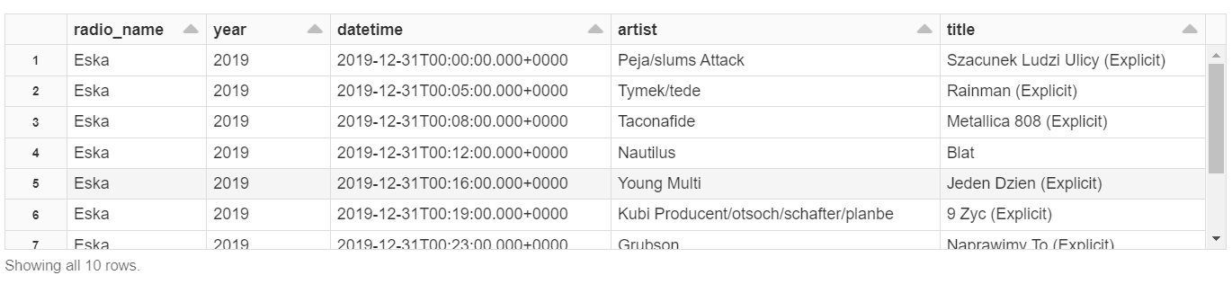
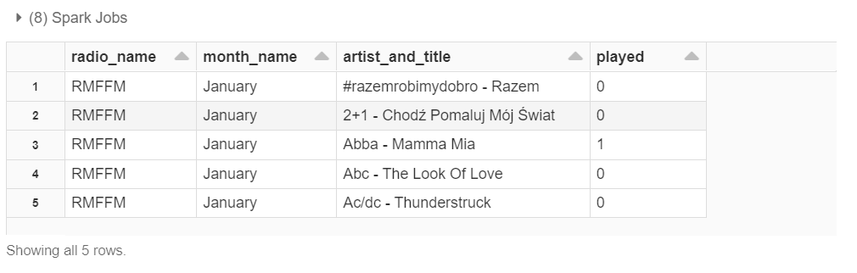
databricks
learn-sth-new-elt-1 notebook get data from raw layer and save to curated layer with proper partitioning
learn-sth-new-elt-2 notebook get data from curated, get unique list of songs, enrich with data from Spotify API, add columns, save to enriched layer as song (dimension) and playlist (fact table)
learn-sth-new-elt-3 notebok create the database and tables inside databricks to be able to connect from 3rd party tools
learn-sth-new-elt-4 notebook create data for machine learning, first unique list of songs, second unique list of radio + year + month, cross join and combine with current playlist, save to analytics layer, save on month level
data lake
raw
curated
enriched
analytics

Slide 25
demo databricks

Slide 26
radio playlist analysis
local
aws
azure
data lake
local

Slide 27
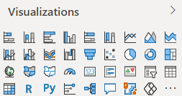
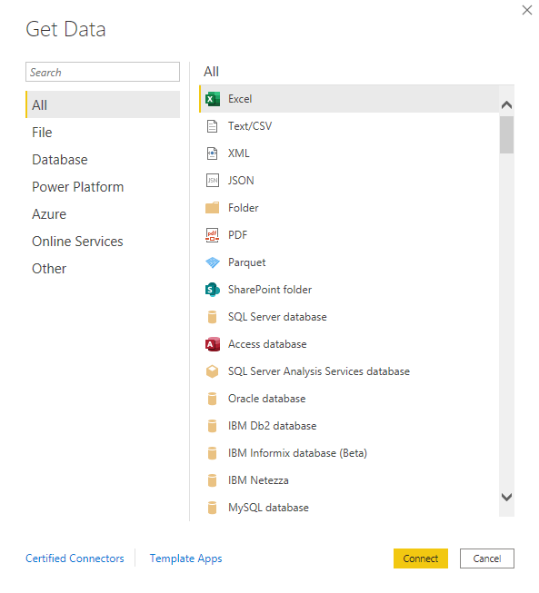
power bi
Power BI - is a business analytics service by Microsoft. It aims to provide interactive visualizations and business intelligence capabilities
Uses the tabular and in memory compression to provide the high performance
Desktop version completely free, also available as cloud service for sharing
Read more: [link], [link], [link], [link], [link]

Slide 28
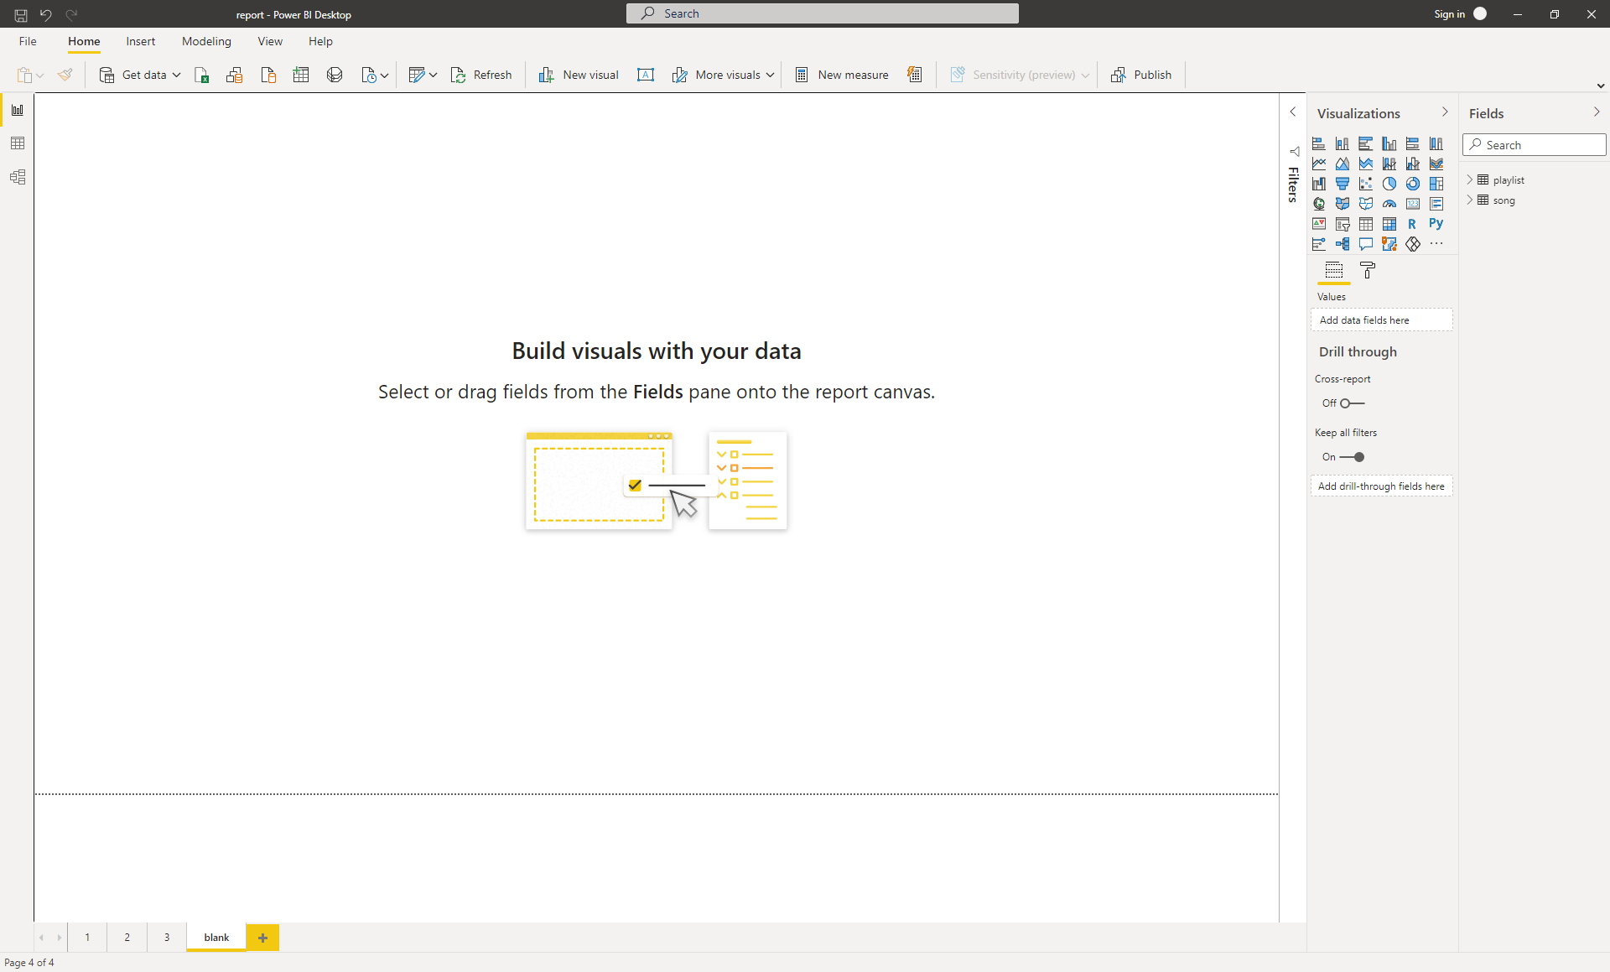
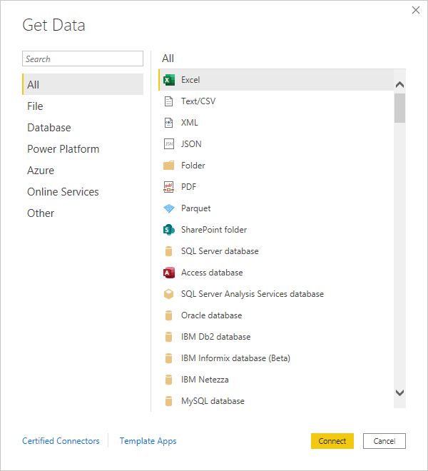
power bi

Slide 29
demo power bi

Slide 30
radio playlist analysis
local
aws
azure
data lake
local

Slide 31
machine learning
Machine learning is an application of (AI) that provides the ability to automatically learn and improve from experience without being explicitly programmed. Say, what? Well, it’s all about the data and predictions
Supervised (S) vs unsupervised (U) supervised uses the existing labels to learn the model predict the target label
Most common tasks Regression (S) – predict a numeric value, like sales, based on previous sales amount Classification (S) – predict the category, like frequent buyer or accidental buyer, based on existing data with categories Clustering (U) – similar to classification, but based on data without categories, algorithm try to find a pattern itself
1
year | customer | productcategory | sales
2018 | C001 | accessories | 100
2019 | C001 | accessories | 120
2020 | C001 | accessories | 130
2021 | C001 | accesories | ?
2
last3monthsale | last6monthsale | numberOfTran | category
100 | 200 | 26 | frequentbuyer
120 | 210 | 31 | frequentbuyer
50 | 100 | 4 | accidentialbuyer
78 | 245 | 44 | ?
3
last3monthsale | last6monthsale | numberOfTran | category
100 | 200 | 26 | ?
120 | 210 | 31 | ?
50 | 100 | 4 | ?
78 | 245 | 44 | ?

Slide 32
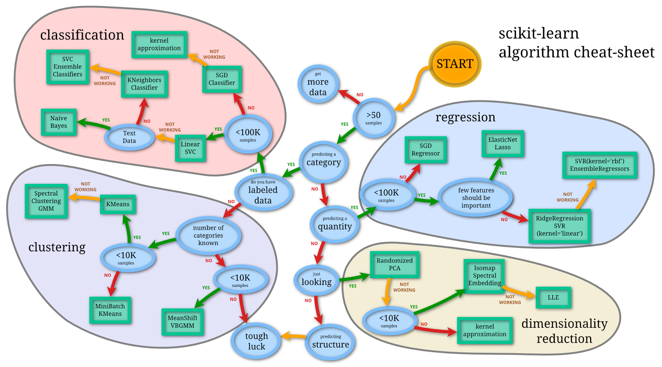
machine learning
Algorithms – to solve that tasks we will use the algorithms
LogisticRegression
DecissionTrees
Etc.
The algorithms are provided by many libarries for many languages, example: scikit-learn
The main problem is to prepare the data and find the algorithm to fit to the data and to the task
Applying the particular algorithm into the dataset to solve the task will create at the end the machine learning model
Read more: [link], [link], [link], [link], [link]
Image source: peekaboo-vision.blogspot.com

Slide 33
machine learning
features
label
get data
year | customer | productcategory | sales
2011 | C001 | accessories | 130
2012 | C001 | accessories | 140
2013 | C001 | accessories | 150
2014 | C001 | accessories | 160
2015 | C001 | accessories | 170
2016 | C001 | accessories | 180
2017 | C001 | accessories | 190
2018 | C001 | accessories | 200
2019 | C001 | accessories | 210
2020 | C001 | accessories | 220
2021 | C001 | accessories | 230
year | customer | productcategory | sales
2011 | 0 | 2 | 130
2012 | 0 | 2 | 140
2013 | 0 | 2 | 150
2014 | 0 | 2 | 160
2015 | 0 | 2 | 170
2016 | 0 | 2 | 180
2017 | 0 | 2 | 190
2018 | 0 | 2 | 200
2019 | 0 | 2 | 210
2020 | 0 | 2 | 220
2021 | 0 | 2 | 230
exploratory analysis
prepare data for analysis
train subset
specify features and labels
split data into train and test subsets
select algorithm, train model
test subset
validate model
year | customer | productcategory | sales _original | sales_predicted
2019 | 0 | 2 | 210 | 210
2020 | 0 | 2 | 220 | 220
2021 | 0 | 2 | 220 | 240

Slide 34
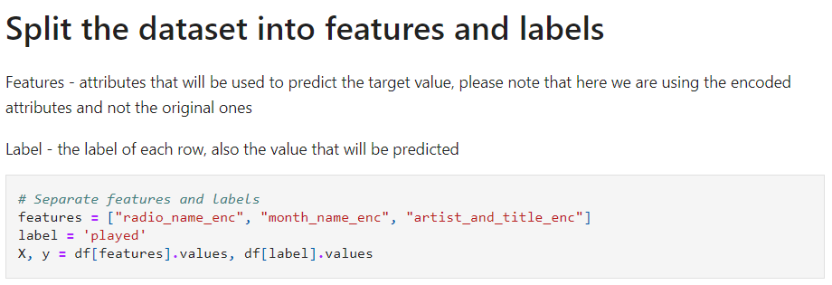
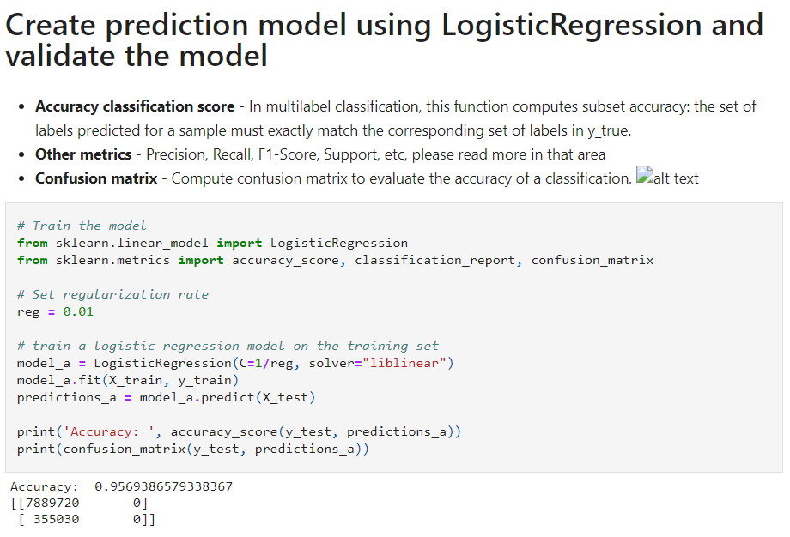
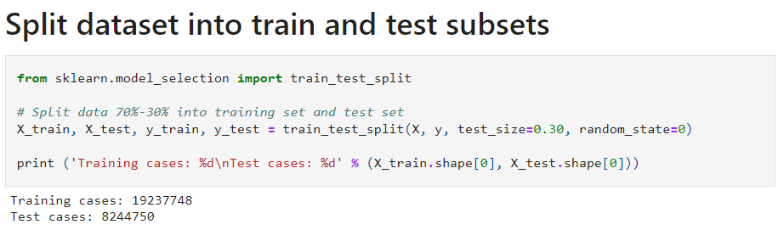
machine learning
1
3
2

Slide 35
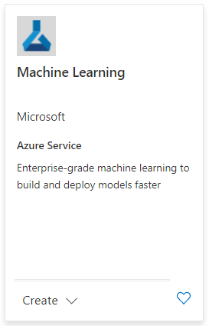
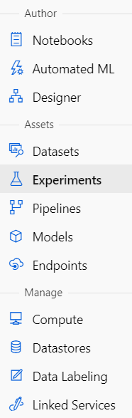
azure machine learning
Azure Machine Learning - Enterprise-grade machine learning service to build and deploy models
Notebook or script style coding or graphic designer including Automated ML
Supports Python and R
End-to-end MLOps
Read more: [link], [link], [link], [link], [link]

Slide 36
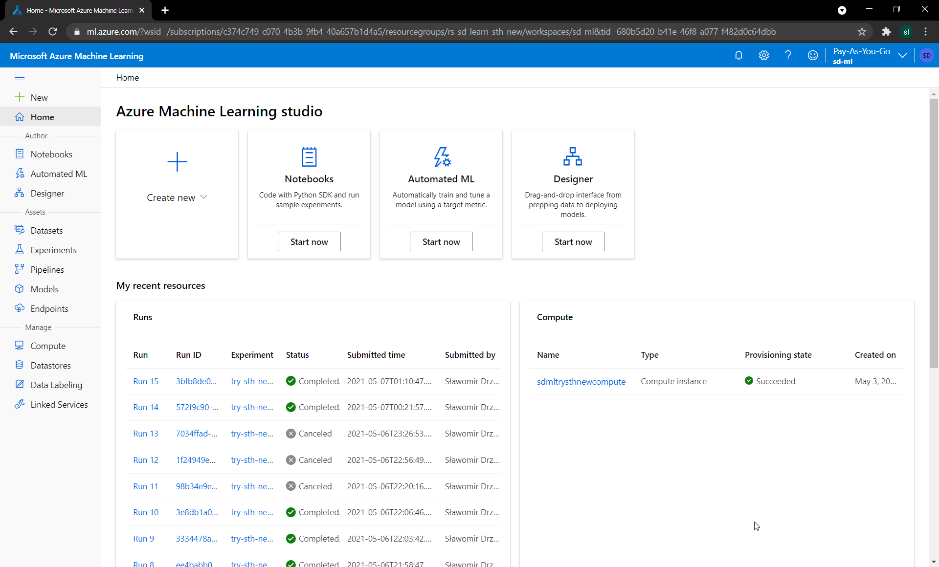
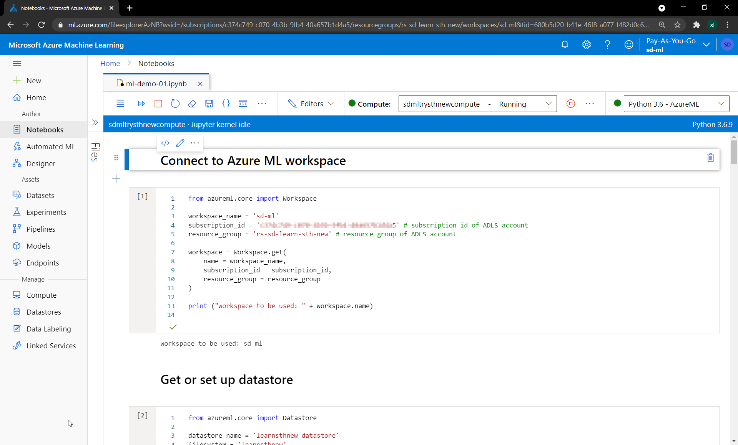
azure machine learning

Slide 37
demo azure machine learning

Slide 38
radio playlist analysis
local
aws
azure
data lake
local

Slide 39
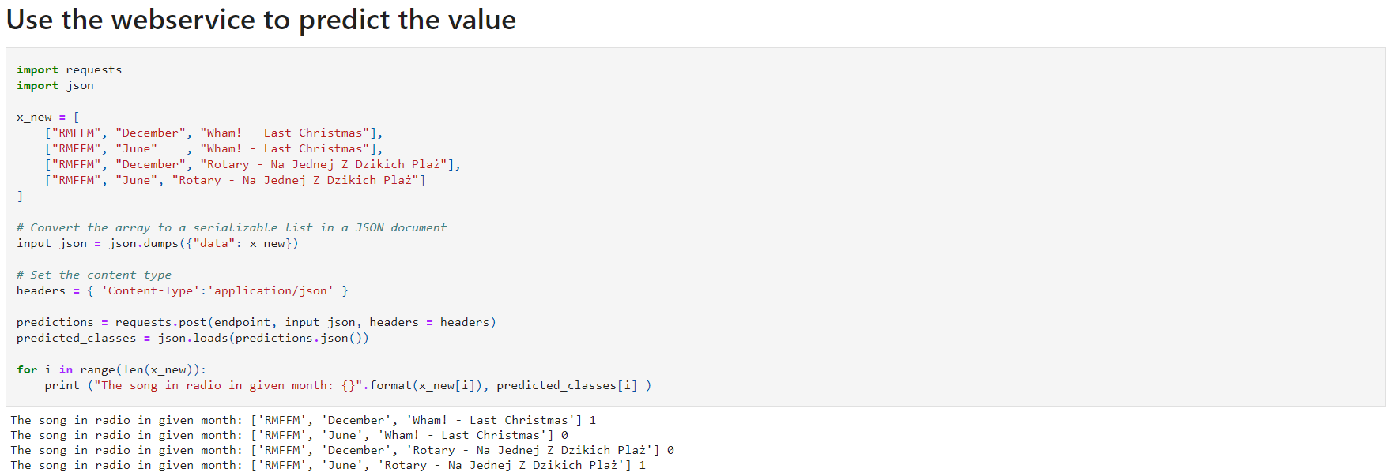
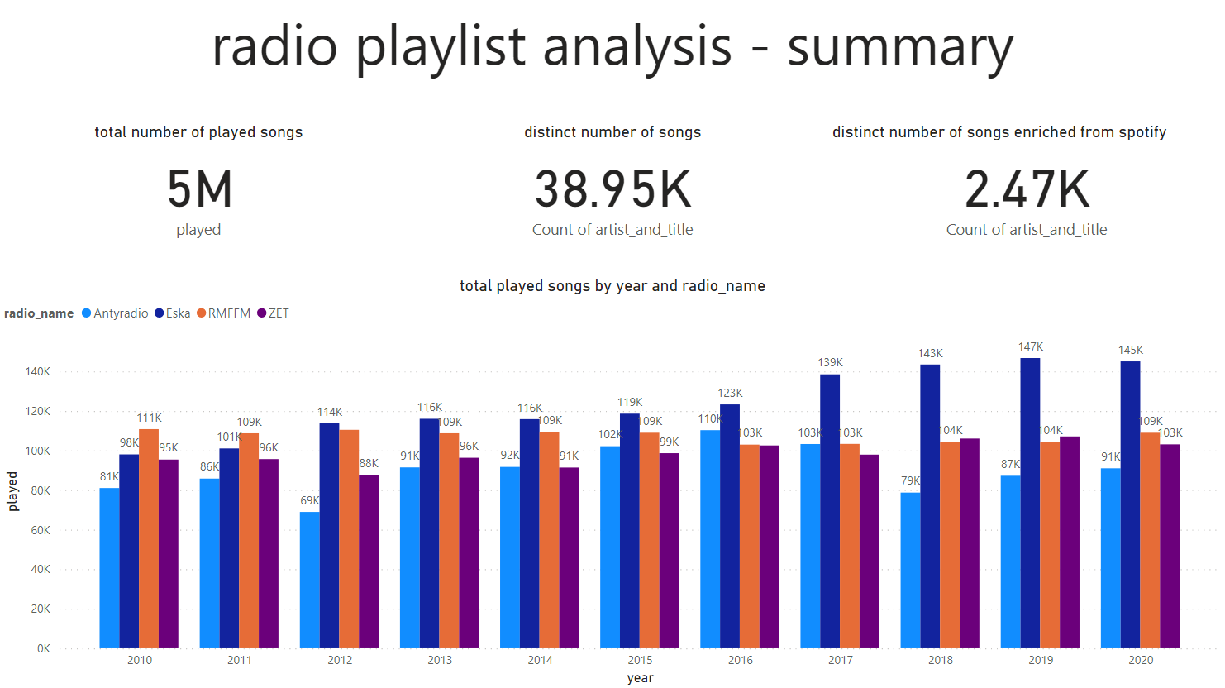
a lot, but not that hard, huh?

Slide 40
recap
local
Code and presentation will be shared, make sure to check
We have seen
Docker
Python
Data lake
Databricks
Power BI
Azure ML
Did u like the topic? blog.prokulski.science [R]
aws
azure
data lake
local
SQLDay 2021

Slide 41







what’s next?

Slide 42

outro - the message
There was many simplifications, but I hope you got the point and see that its easy!
Create your own pet project with data you like and technologies you like
Also
Keep yourself updated
Be prepared for a change
Slice the elephant
Remember about the free tools and Azure free* credits
Try / Learn something new!

Slide 43
So, why not to learn something new?
Sławomir Drzymała
slawomirdrzymala@outlook.com
sdrzymala
SDrzymala
sdrzymala
seequality

